Slide 1


Slide 2
Agenda
Domain : Healthcare
Project Name : P148(Healthcare Analytics )
Background :
1) Client Scenario
2) ETL Process
3) Problem Solving
4) Visualizing Analytical Insides
5) Dashboard Preparation

Slide 3
Project Group Details
Project Group No: 03
Praveenraj Hayyalkar.
Akash Bhadreshbhai Joshi.
Anurag Shashikant Shinde.
Indrajeet Vasant Mali.
Jayant Rai.
Teju Bharath.
Himanshu Kamble.

Slide 4
Problems To Solve
Total Discharge
Patient Days
Net Patient Revenue
Patient Stays
State Wise No of hospital /Revenue
MTD/QTD/YTD Revenue
Total Hospital
Revenue Trend

Slide 5
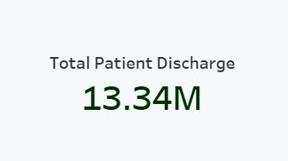
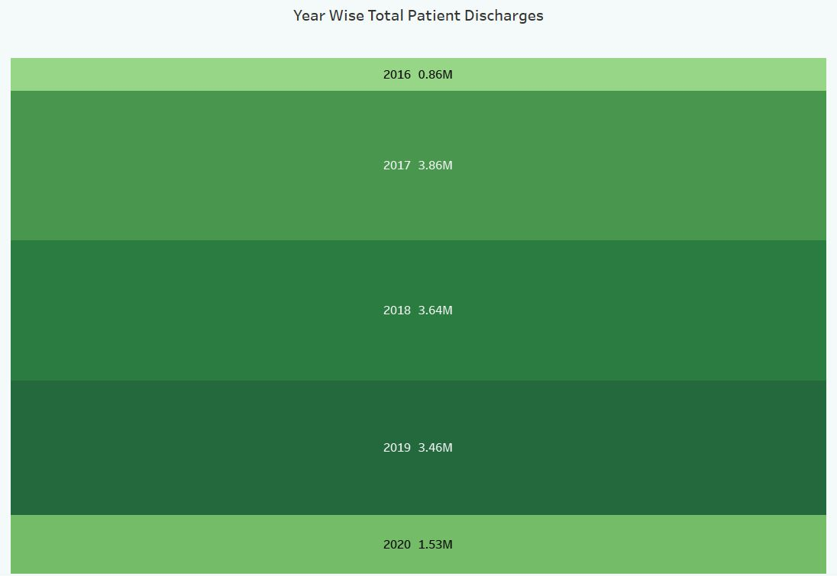
Total Discharge
Here, we can see that the Total Patient discharge was 13.34M .
In addition, We can see yearwise total patient discharge. In 2016-0.86M ,2017-3.86M, 2018-3.64M and so on.
In all five years total discharge in Quarter 1 is highest among other quarters.
From all payers source medical and medicare leads highest discharges .
Medical & Medicare has highest payer source which is 14.93K & 31.25K respectively, Others must work on their discharge count .

Slide 6
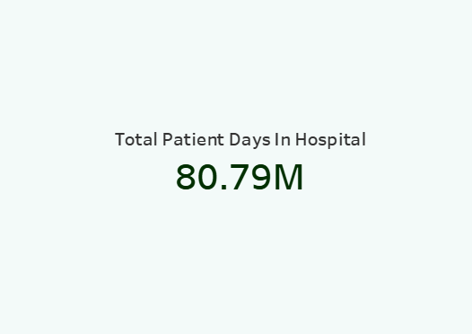
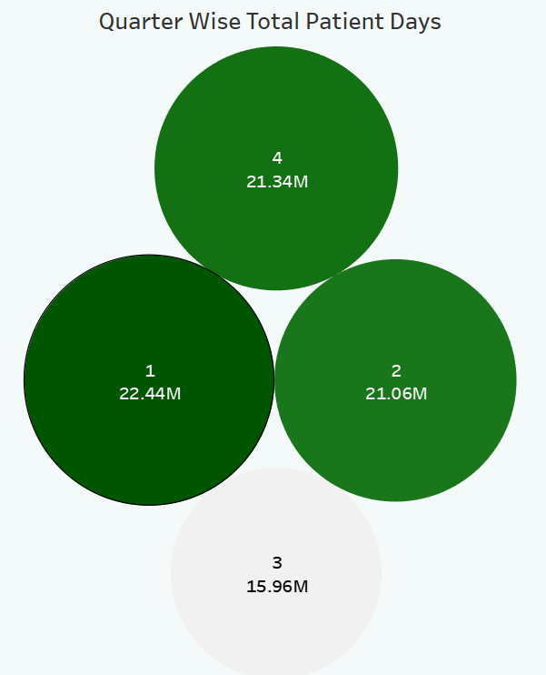
Patient Days
Total Patient days in hospital are 80.79M.
Yearwise total patient days are in 2016 -5.25M, 2017-22.50M and so on.
As we see in 1^{st,} KPI Total patient days in Quarter 1 are highest among all .
From all payers source medical and medicare leads highest Patient Days which is 13.02m & 22.36M respectively..
Apart from Medical & Medicare the other traditional payer sources has to improve their services.

Slide 7
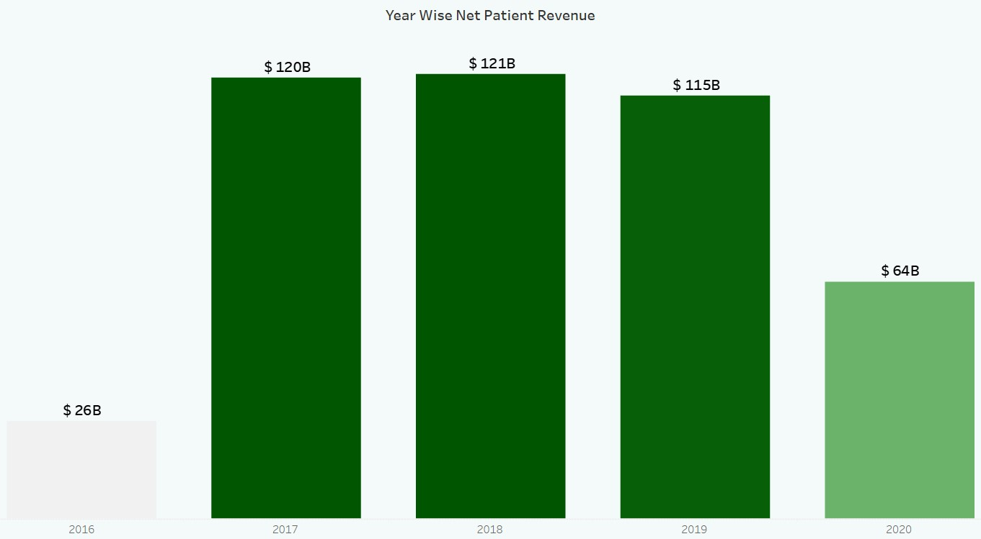
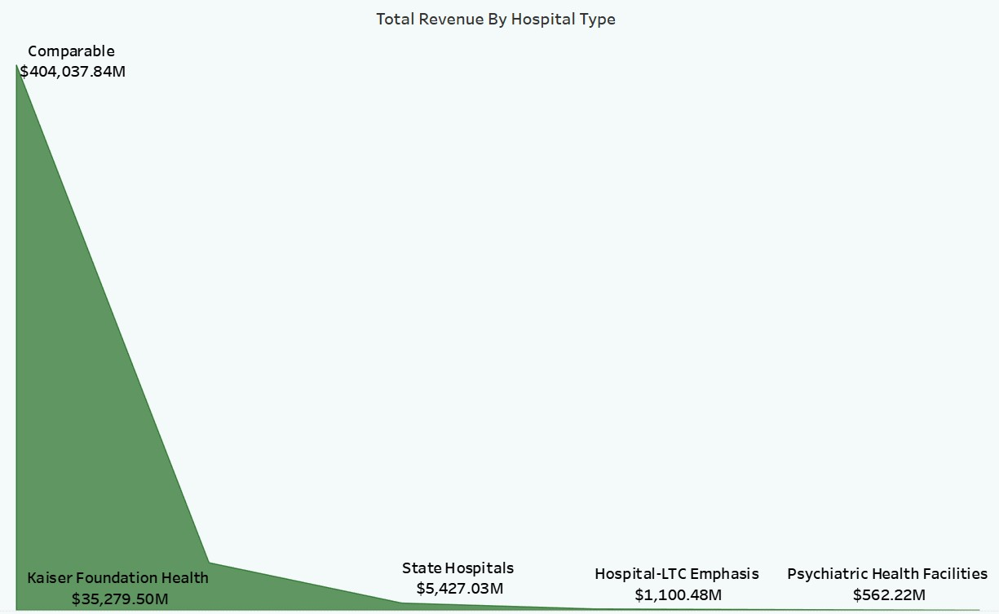
Net Patient Revenue
Yearwise net patient revenue vary year by year 2016 had 26B ,2017 -120B ,2018-121B and so on.
By the Quarterwise revenue the 3rd quarter made the lowest and 1st quarter made the highest revenue among all .
Comparable and Kaiser Hospital make 70% of revenue.
State , LTC-Emphasis , Psychiatric hospitals should develop their facility ,equipments and serives to make higher revenue .

Slide 8
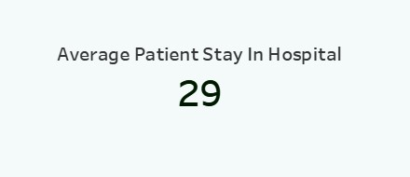
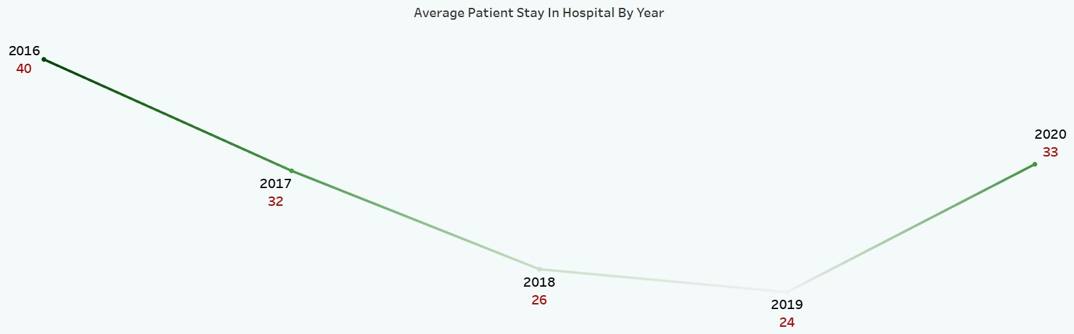
Patient Stays
The Average Patient Stay in Hospital is 29 Days .
Average patient stay in Hospital in 2016- 40, 2017- 32 ,2018-26 and so on.
Year 2019 has the lowest stay which is 24 & year 2016 has highest stay of 40 Days.
State hospital has highest patient stay of 870 and Kaiser hospital has lowest stay of 4 days only .
For patients bed avaibility every hospital should work on patients minimum stay ,so every patient should get proper treatment.

Slide 9
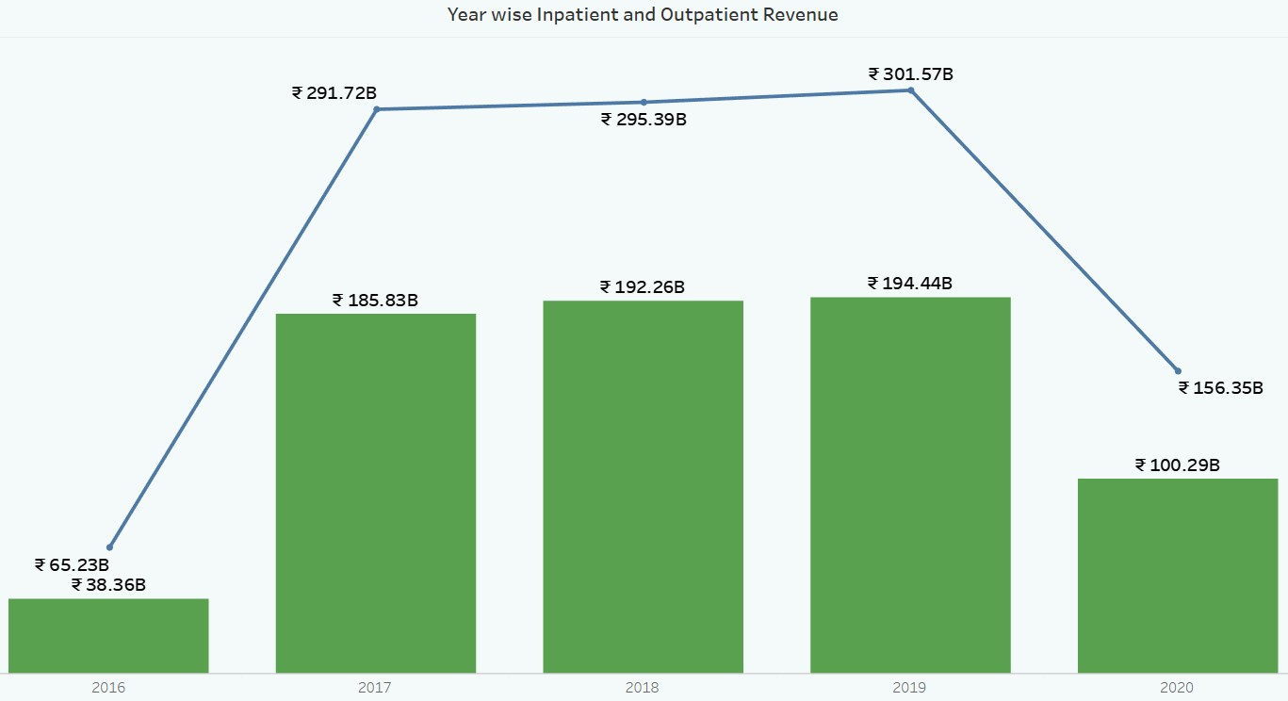
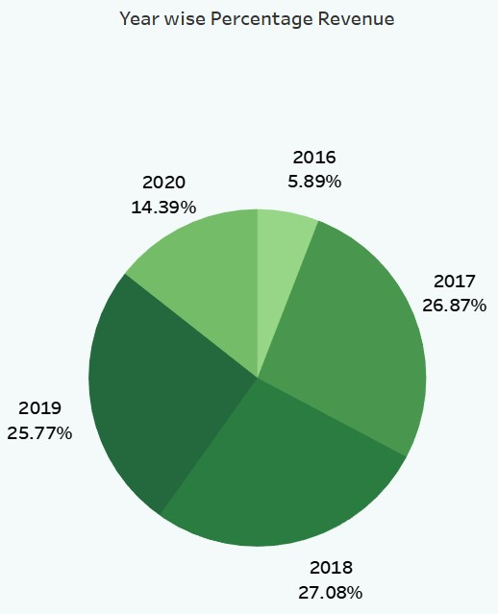
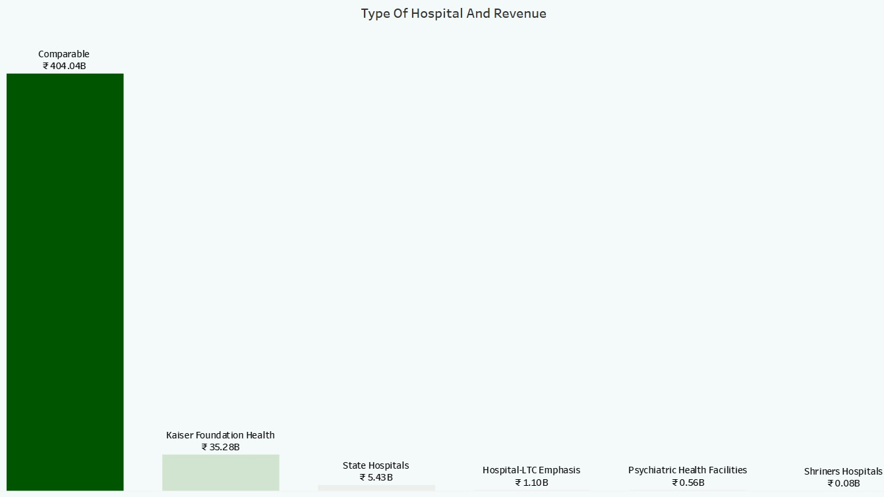
State Wise No of hospital /Revenue
As we can see in in Bar chart Comparable hospital has highest revenueof $ 404B statewise.
Year 2018 has 27.08% and 2016 has 5.89% revenue and so on.
Inpatient and outpatient revenue vary from year to year .
The revenue is increasing year by year .In 2016 it is lowest in 2019 the revenue is at it’s peak and In 2020 the downfall occurs.

Slide 10
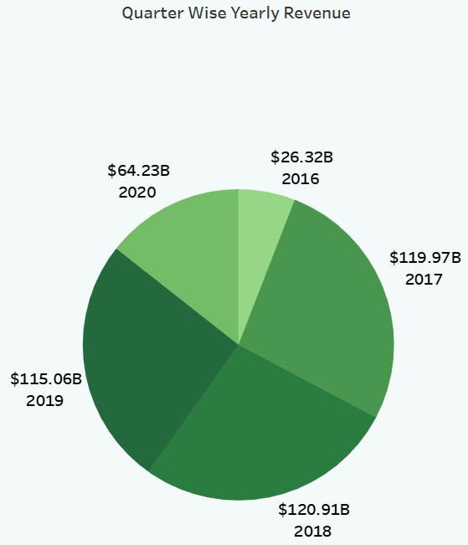
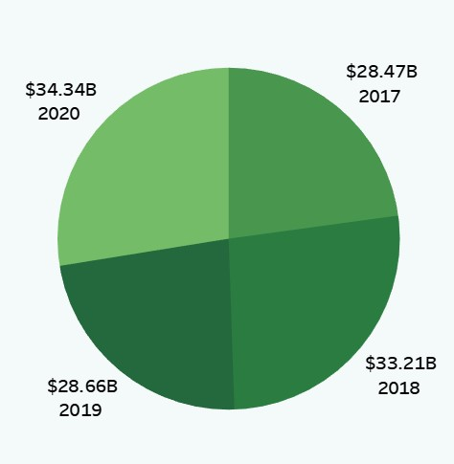
MTD/QTD/YTD Revenue
The 1st pie shows QTD revenue by each year .
Quarterwise yearly revenue
- 2016 : 26.32B
- 2017 : 119.97B
- 2018 : 120.91B
- 2019 : 115.06B
- 2020 : 64.23B
2nd Pie shows YTD Revenue.
- 2017 : 28.47B
- 2018 : 33.21B
- 2019 : 28.66B
- 2020 : 34.34B

Slide 11
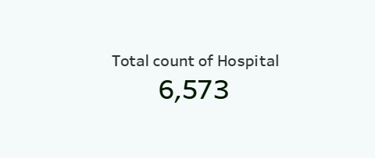
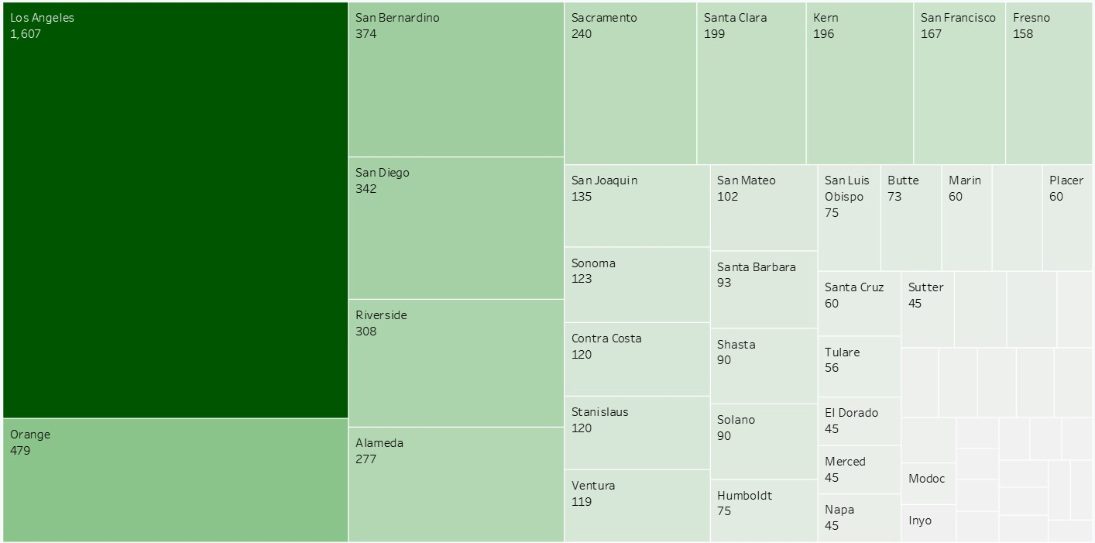
Total Hospital
The Total count of hospital is 6573.
We’ve a tree chart that shows us the count of hospitals Citywise .
According to the chart Los Angeles has highest count of hospital of 1,607.

Slide 12
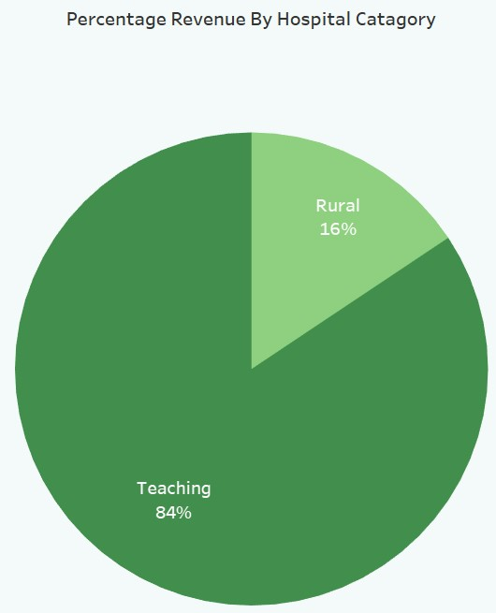
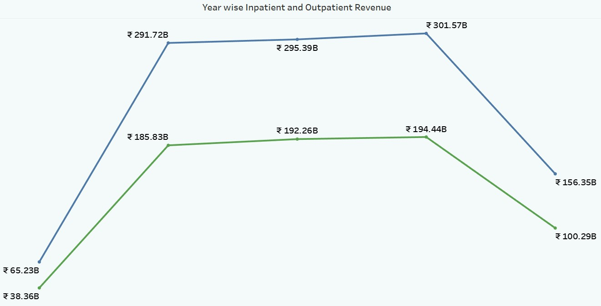
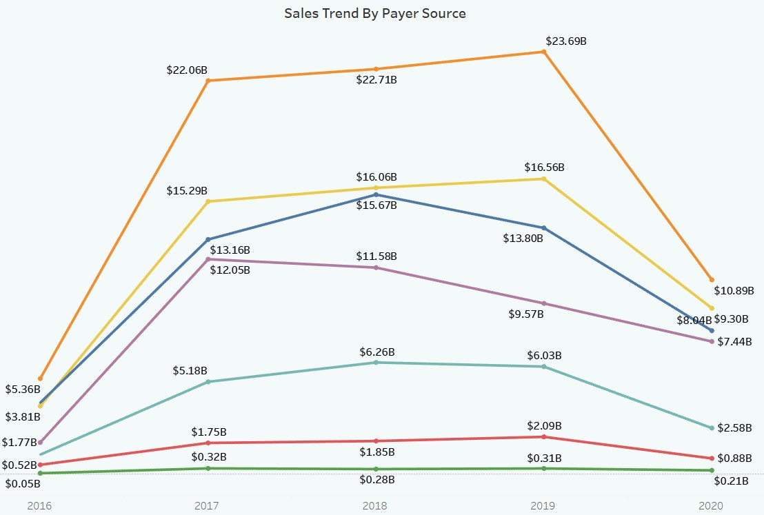
Revenue Trend
The Line Chart shows us different revenue trend by payer source.
Medicare has highest trend among all and Net County has the lowest straight trend .
There are two hospital categories : Rural & Teaching they share 16% & 84% revenue respectively.
There is no stable revenue trend in any category they had an upward and downward fall in their revenue.They should work for steady revenue graph.

